Slide 1


Practice 0
Sofware Development Frameworks
ETSID
Título de Grado en Electrónica Industrial y Automática
Notes:
1

Slide 2
Objetives
At the end of this lesson, students should be able to properly:
Define Version Control System (VCS) concept.
Manage (ex. create, commit, push, issues etc…) software repositories using VCS Github.
Define Interface Development Enterprise (IDE) concept.
Manage (write source code, compile, debug and execute etc…) implementation process using IDE DevC++.

Slide 3
Índex
Software development process
Version Control system
GitHub
Registration
Your first repository (arapractice00face)
GitHub Desktop
Installation & Configuration
Your first local repository (practice00face clone)
Integrated Development Environment
Devc++ IDE Framework
Installation & Configuration
Practice 00 Face

Slide 4
Software development process
Phases of software development
Definition problem.
Algorithm Design.
Flowchar or pseudocode.
Implementation.
Framework Dev C++ IDE.
Execution and validation of the program
GitHub + Jenkins Frameworks.
Documentation.
Maintenance of the program. In this phase the programs are updated (creating new versions) if new functionalities are required or problems are detected.
Practice 0
DevC++
GitHub

Slide 5
Índex
Software development process
Version Control system
GitHub
Registration
Your first repository (arapractice00face)
GitHub Desktop
Installation & Configuration
Your first local repository (practice00face clone)
Integrated Development Environment
Devc++ IDE Framework
Installatatiom & Configuration
Practice 00 Face

Slide 6
Version Control System
A Version Control System (VCS) is a software configuration management of computer programs.
When a program is finished without errors are usually identified by a number or letter code (ex. Version 1).
When the first change is made, the resulting set is a new version (ex. Version 2), and so on.
Each revision is associated with a timestamp and the person making the change. Revisions can be compared, restored etc….
There are a lot of VCS, the most common are the follow:
Apache Subversion, Microsoft Visual SourceSafe, Git …
We are going to use GitHub, which is a framework that implement Git VCS.

Slide 7


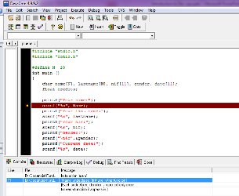

Version Control System GitHub Arquitecture
GitHub Desktop (Client)
GitHub Server
Local Computer (Laptop, PC…)
Local Database
Database
Ver
Push
Repository
Ver
Repository
Source Code
Files .c
Commit
Version 3
Version 3
Clone
Version 2
Version 2
Version 1
Version 1
DevC++ IDE
THE CLOUD (INTERNET)

Slide 8
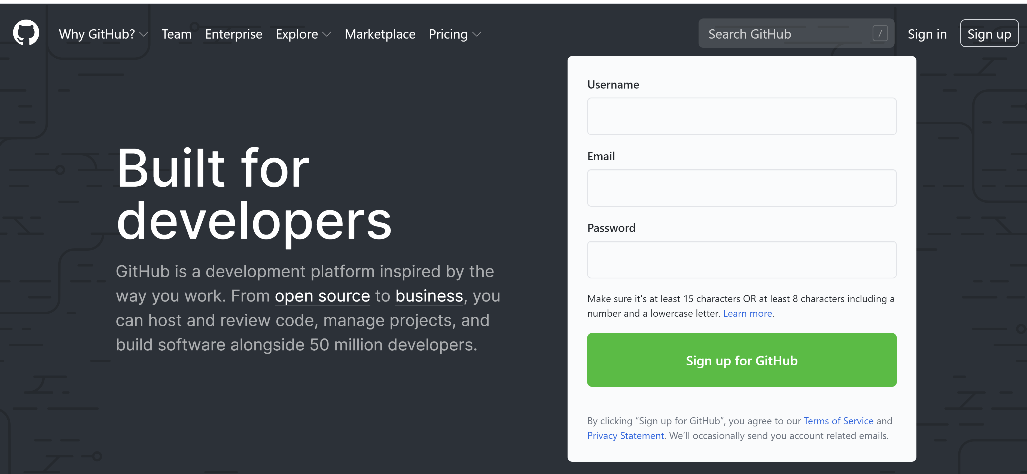
Version Control System GitHub - Registration
To register to GitHub, you should:
Step 1. Entry to this address:
https://github.com/

Slide 9
Version Control system GitHub - Registration
Step 2. If you don’t have an account, press the link “sign up”

Slide 10
Version Control system GitHub - Registration
Step 3. Introduce your user data as follows:
Userdata: <ARA”your UPV user”> ex. ARAjosegqui
Email address: <your ETSID email> ex. josegqui@etsid.upv.es>
Password: <any> Don’t forget the password
Step 4. Verify your account
Step 5. Press “Create account”

Slide 11
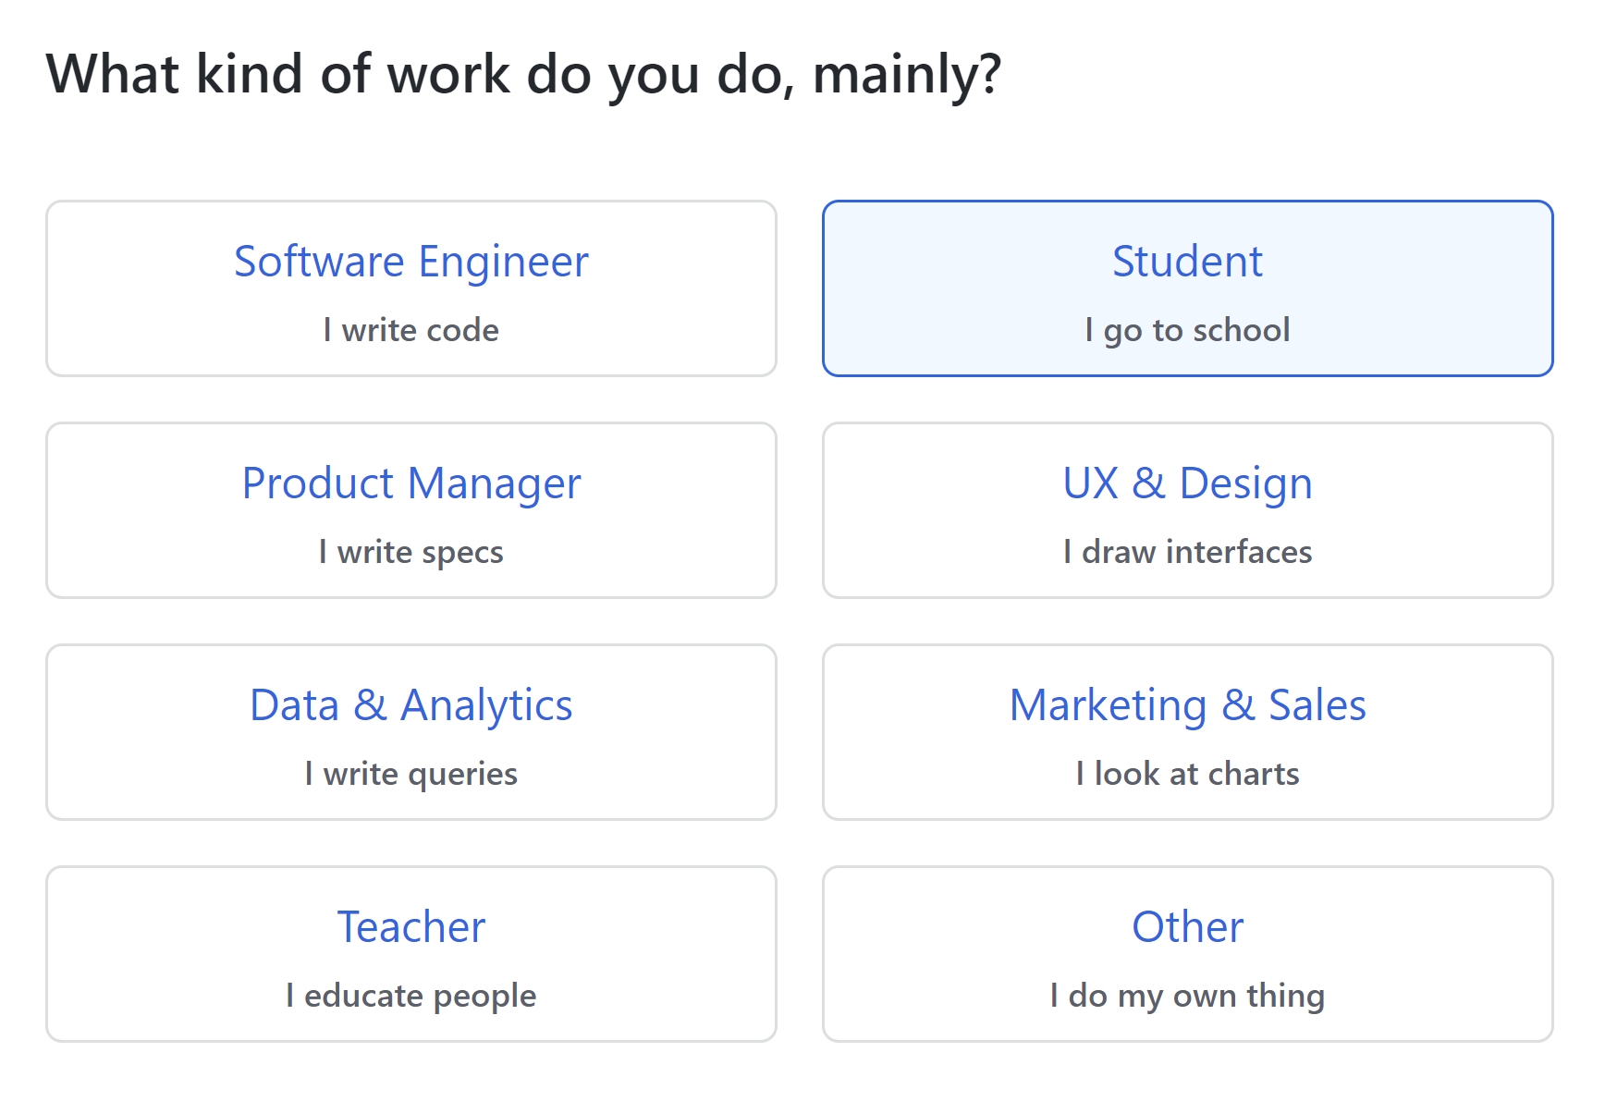
Version Control system GitHub - Registration

Slide 12
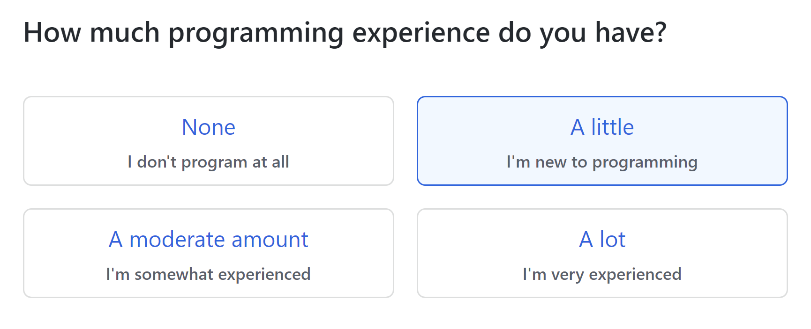
Version Control system GitHub - Registration

Slide 13
Version Control system GitHub - Registration

Slide 14
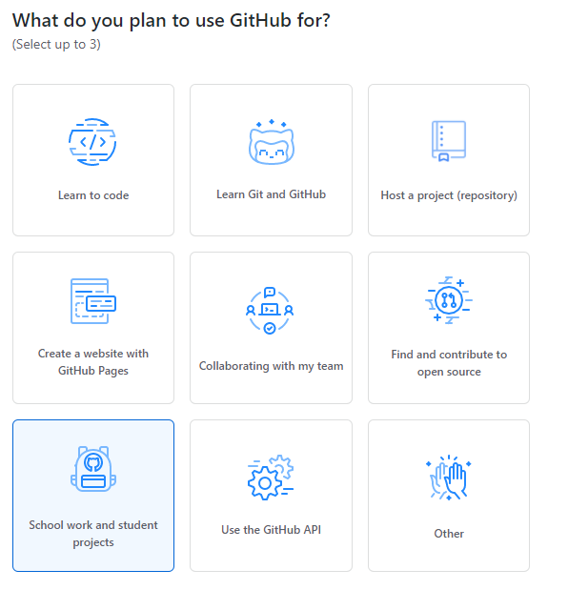
Version Control system GitHub - Registration

Slide 15
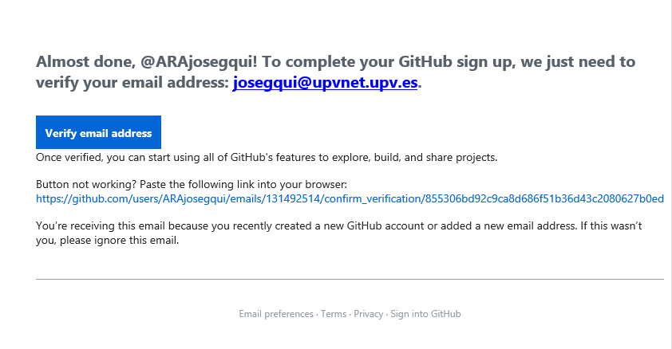
Version Control system GitHub - Registration
Step 6. You will receive an email to verify the GitHub account. Press to the “verify email address”.

Slide 16
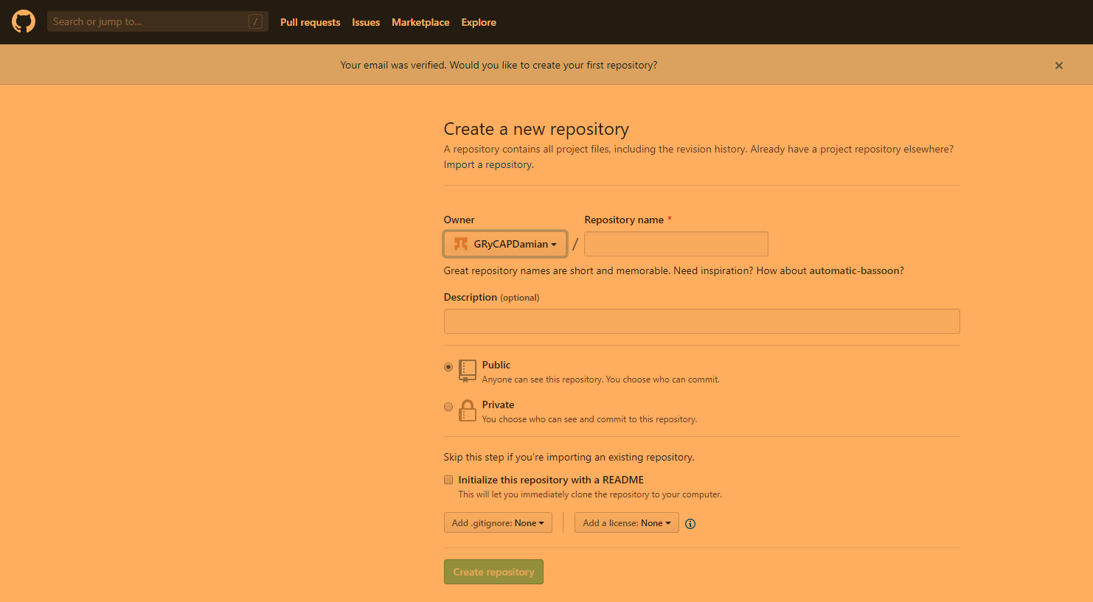
Version Control system GitHub - Registration
Step 7. You don’t create any repository.
Click on the GtitHub picture to go to the home

Slide 17
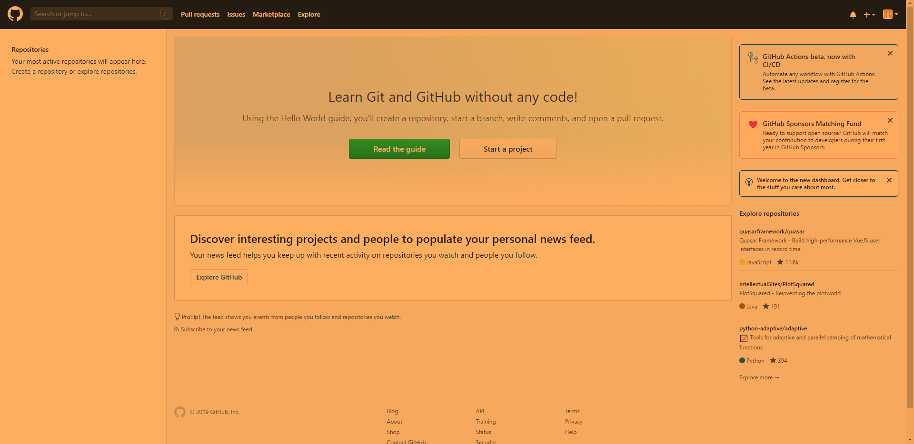
Version Control system GitHub - Registration
Step 8. In this moment you have an account in GitHub.
Congratulations !!!!
You are already a GitHub User !!!

Slide 18
Version Control System GitHub - Your first repository (arapractice00face)
We are going to create your first repository which corresponds to the practice 00 Face. The steps to perform are the follows:
Step 1. Open the URL (Chrome, Internet Explorer …) which corresponds the task of practice 00 (face). The URL will be similar to this:
https://classroom.github.com/a/DKgtt3tD
Choose your name from the list and click on it.

Slide 19
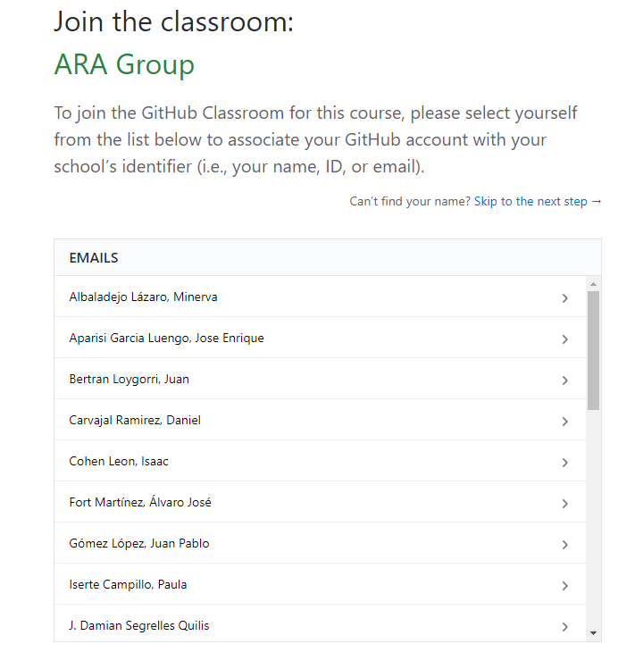
Version Control System GitHub - Your first repository (arapractice00face)
Step 2. Choose your name.

Slide 20
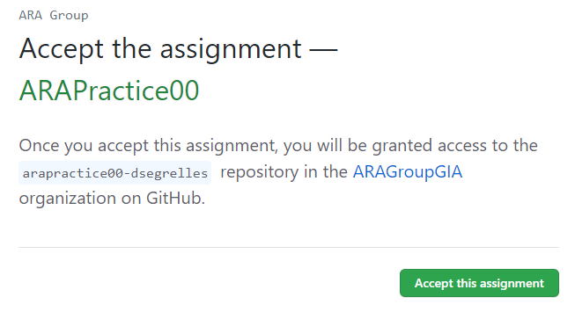
Version Control System GitHub - Your first repository (arapractice00face)
Step 3. Accept the assignement.

Slide 21
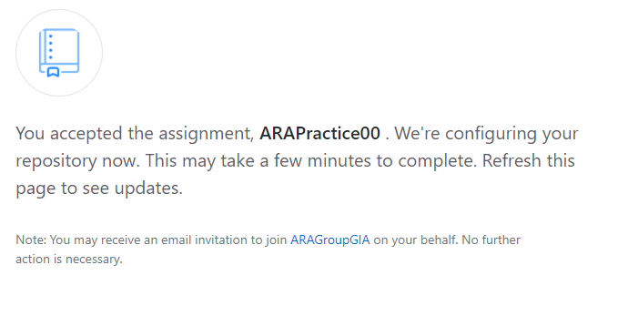
Version Control System GitHub - Your first repository (arapractice00face)
Step 4. Wait until you receive an email confirming that your repository has been clone.

Slide 22
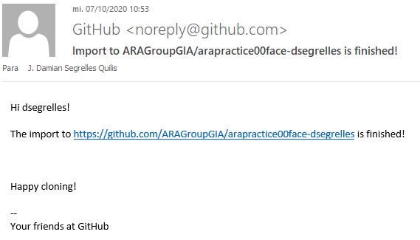
Version Control System GitHub - Your first repository (arapractice00face)
Step 5. Consult your e-mail.

Slide 23
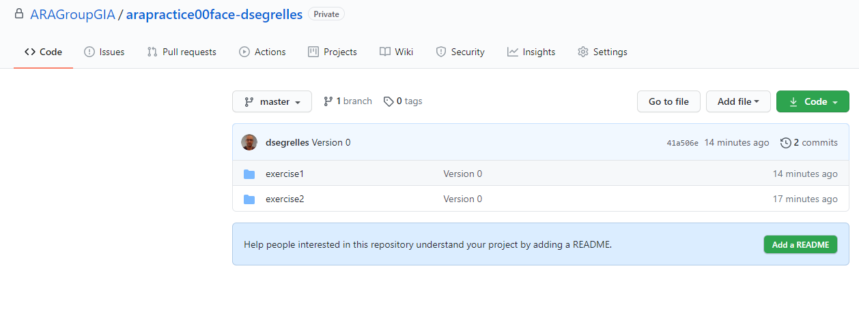
Version Control System GitHub - Your first repository
Step 6. You can access to the repository using your GitHub account or clicking in the URL that it is showed in the received e-mail.

Slide 24
Version Control System GitHub
GitHub Desktop (Client)
GitHub Server
Local Database
Database
Ver
Push
Repository
arapractice00face
Ver
Repository
Source Code
Files .c
Commit
Version 3
Version 2
Clone
Version 0
Version 1
THE CLOUD (INTERNET)
DevC++ IDE
Ready to Go
Local Computer (Laptop, PC…)

Slide 25
Índex
Software development process
Version Control system
GitHub
Registration
Your first repository (arapractice00face)
GitHub Desktop
Installation & Configuration
Your first local repository (practice00face clone)
Integrated Development Environment
Devc++ IDE Framework
Installation & Configuration
Practice 00 Face

Slide 26
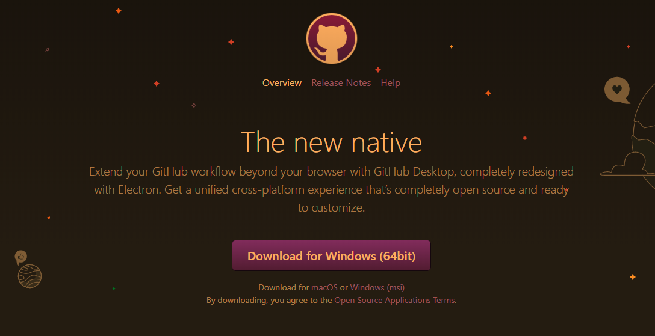
Version Control System GitHub Desktop – Installation & Configuration
To Install at your personal computer the GitHub Desktop, you should:
Step 1. Entry to this address:
https://desktop.github.com/

Slide 27
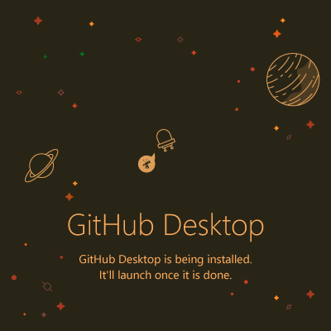
Version Control System GitHub Desktop – Installation & Configuration
Step 2. Download the installation file and execute it.

Slide 28
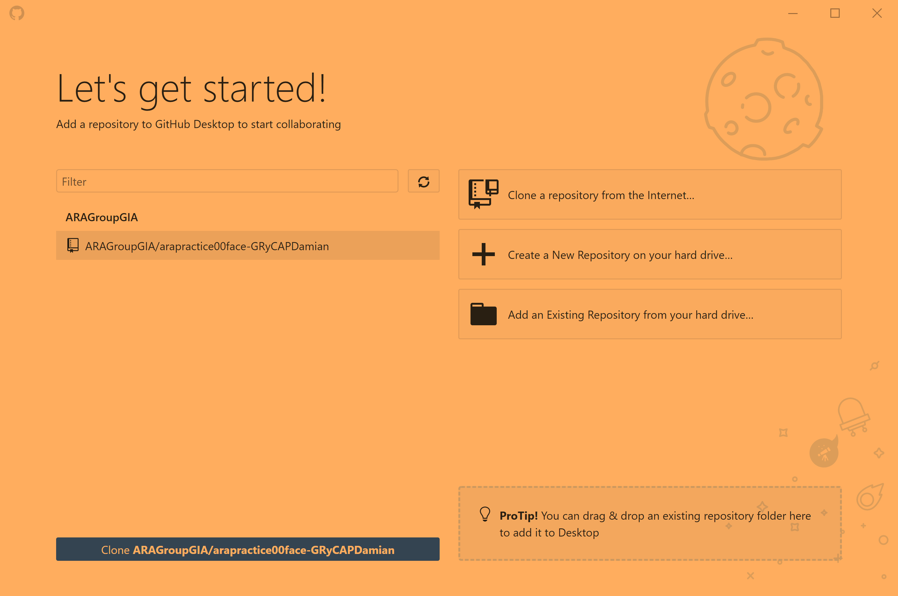
Version Control System GitHub Desktop – Installation & Configuration
Step 3. Configure GitHub Desktop introducing your Github account (User and Password).
Step 4. Clone the repository of practice 00 (arapractice00face) at the local machine. For that, first you choose the option “Clone repository from the internet”.

Slide 29
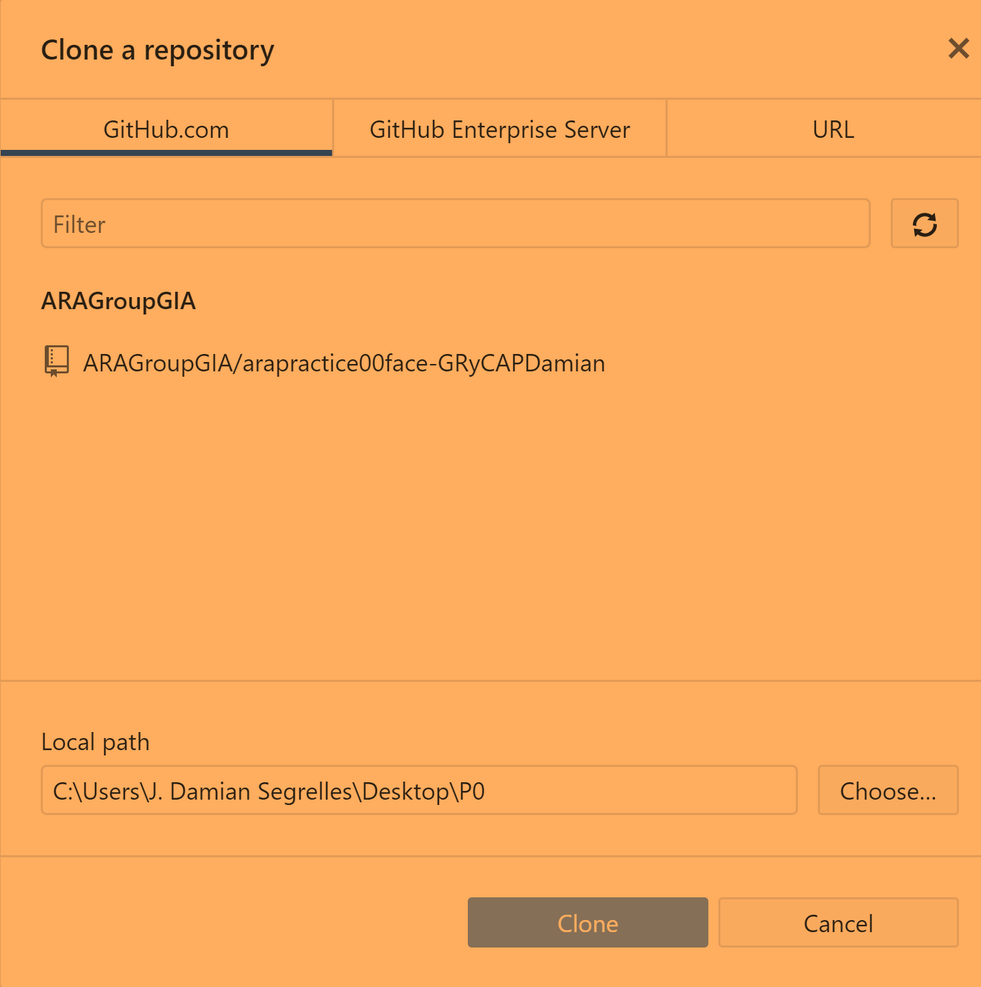
Version Control System GitHub Desktop – Installation & Configuration
Step 5. Choose the repository to clone (in this case “ARAGroupGIA/arapractice00face-…”) and the local path (in your computer) where the repository will be cloned.

Slide 30
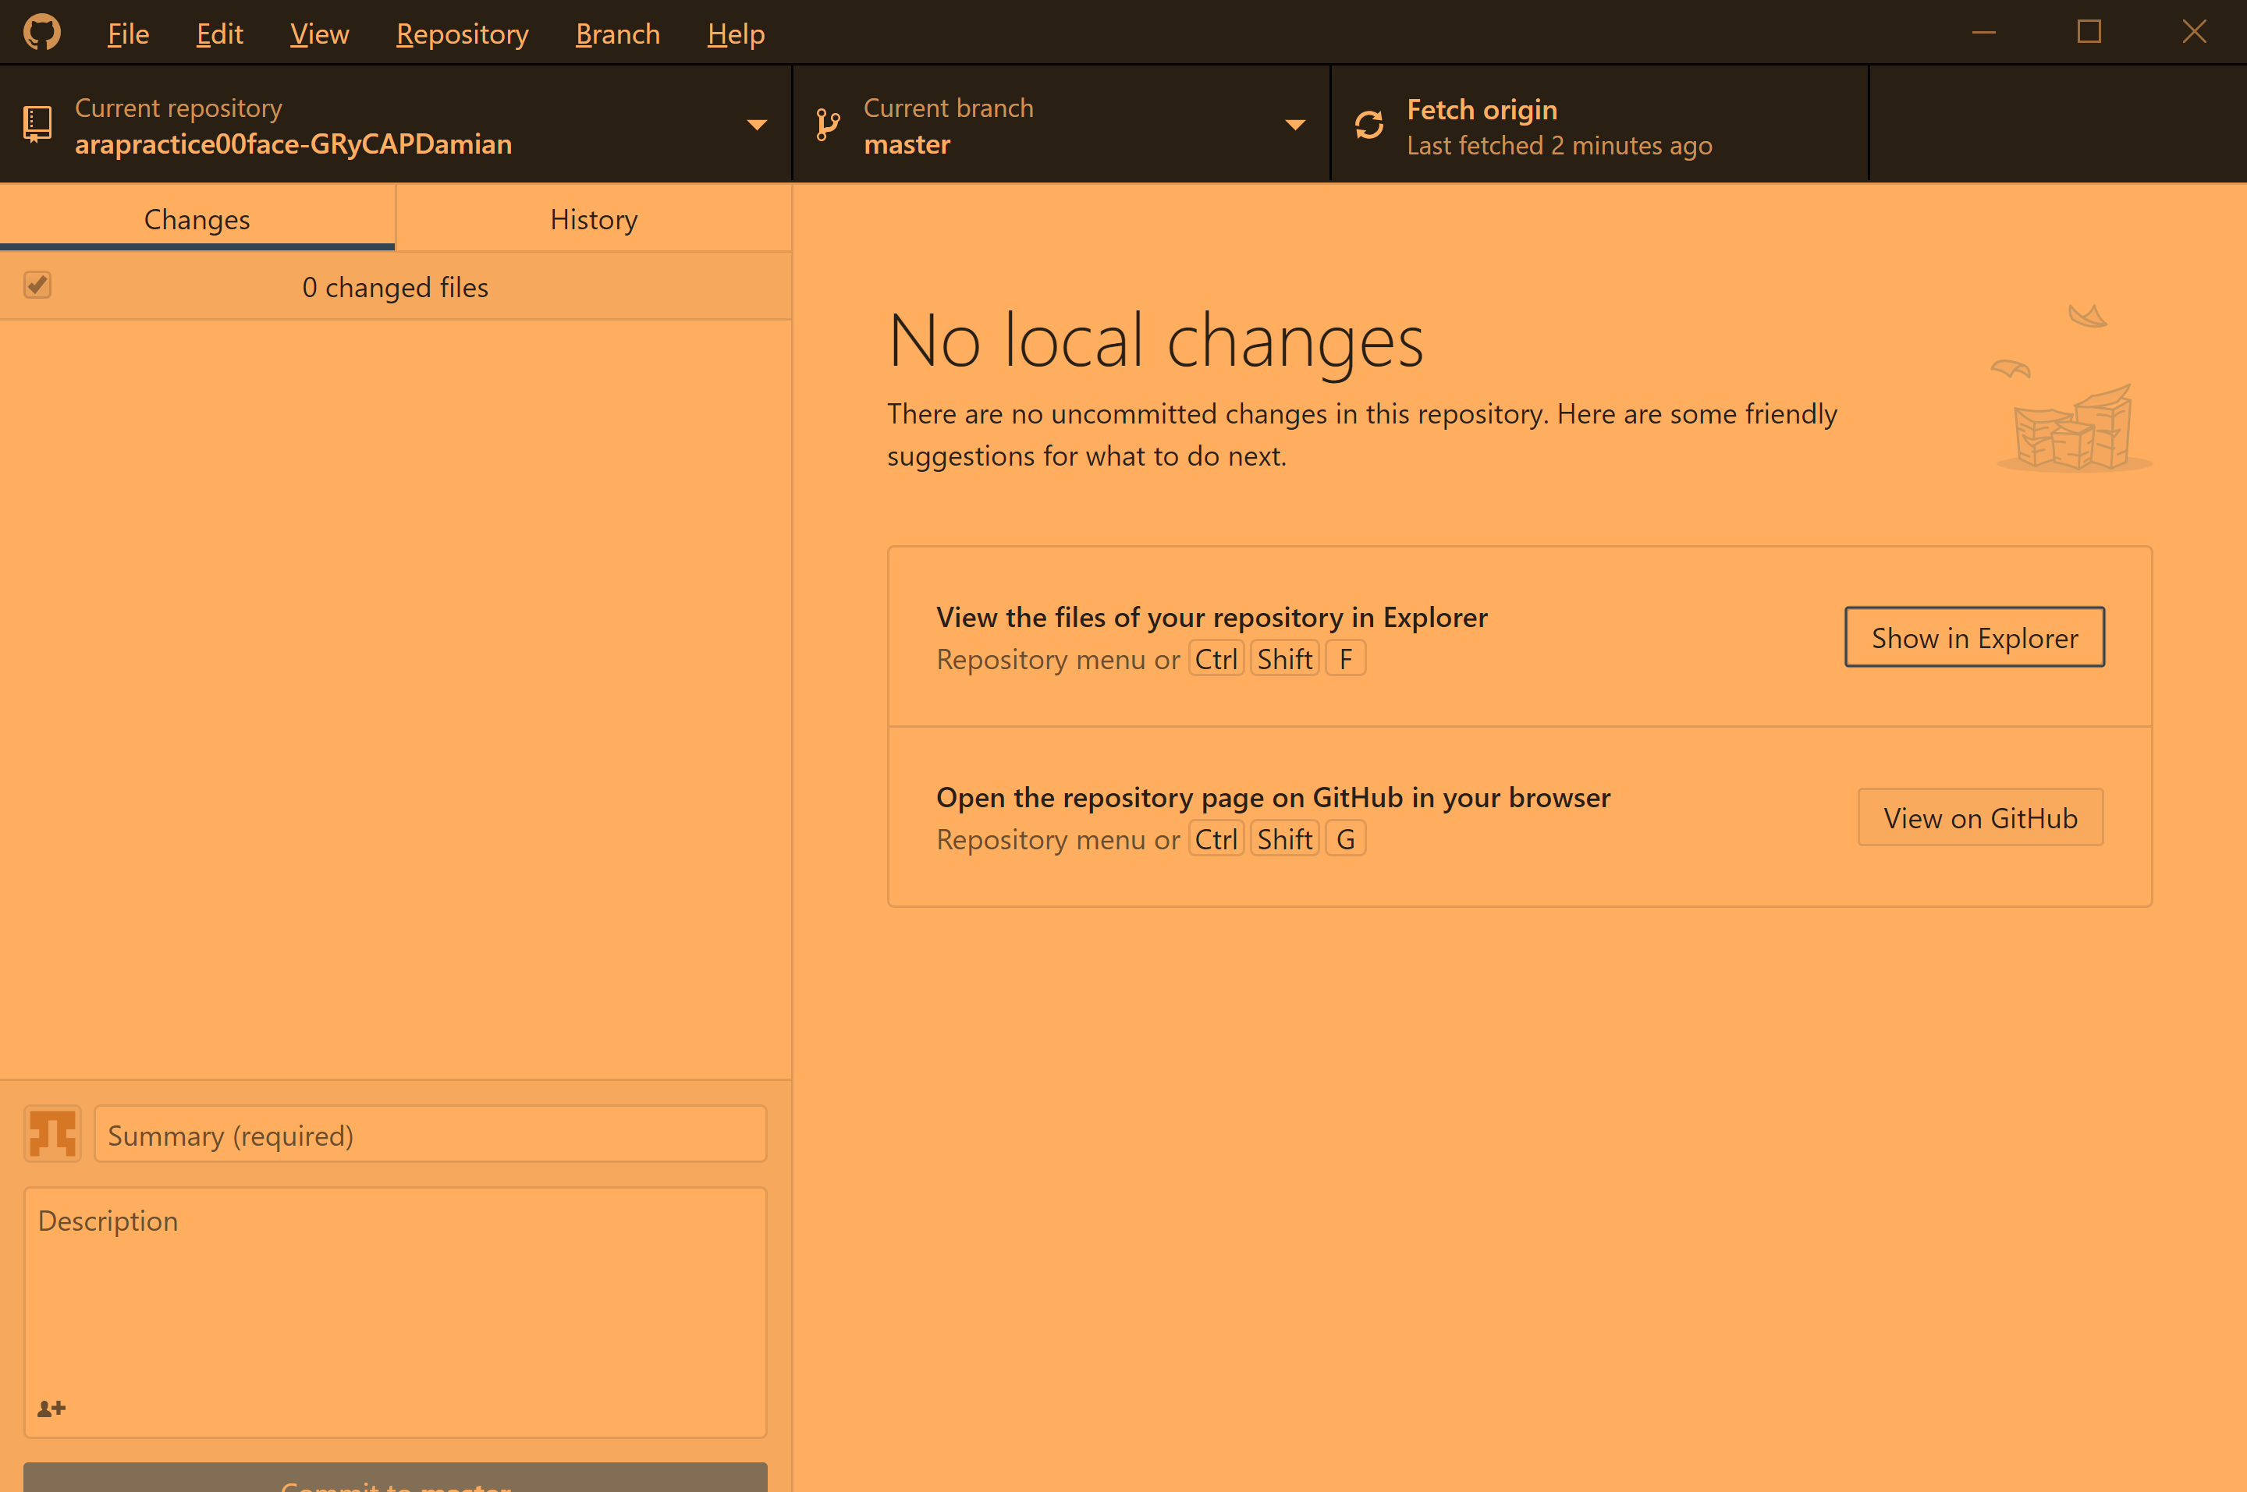
Version Control System GitHub Desktop – Installation & Configuration
Step 6. Automatically, in your local machine a new folder will be created with the same files of your GitHub repository. You can explore the local files choosing “show in explorer” and also the GitHub files on the cloud choosing “view on GitHub”

Slide 31
Version Control System GitHub Desktop – Installation & Configuration
Congratulations !!! You are ready to start the practice00 and develop your own programs

Slide 32
Version Control System GitHub
GitHub Desktop (Client)
GitHub Server
Ver
Local folder
Push
Repository
arapractice00face
Ver
Clone repository arapractice00face
Source Code
Files .c
Commit
Clone
Ready to Go
Version 0
Version 0
THE CLOUD (INTERNET)
DevC++ IDE
Ready to Go
Local Computer (Laptop, PC…)

Slide 33
Índex
Software development process
Version Control system
GitHub
Registration
Your first repository (arapractice00face)
GitHub Desktop
Installation & Configuration
Your first local repository (practice00face clone)
Integrated Development Environment
Devc++ IDE Framework
Installation & Configuration
Practice 00 Face

Slide 34
Integrated Development System
An Integrated Development Environment (IDE) is software application that provides comprehensive facilities to computer programmers for software development.
An IDE normally consists of at least a source code editor, build automation tools (compile), and a debugger.
Some examples are NetBeans, Eclipse, Developer studio, DevC++ etc...

Slide 35
Integrated Development System Dev-C ++ IDE Framework
You may download Dev-C++ from the web site:
https://sourceforge.net/projects/orwelldevcpp
Also, you can download from poliformaT a portable version that it don’t require installation (Recommend !!).

Slide 36
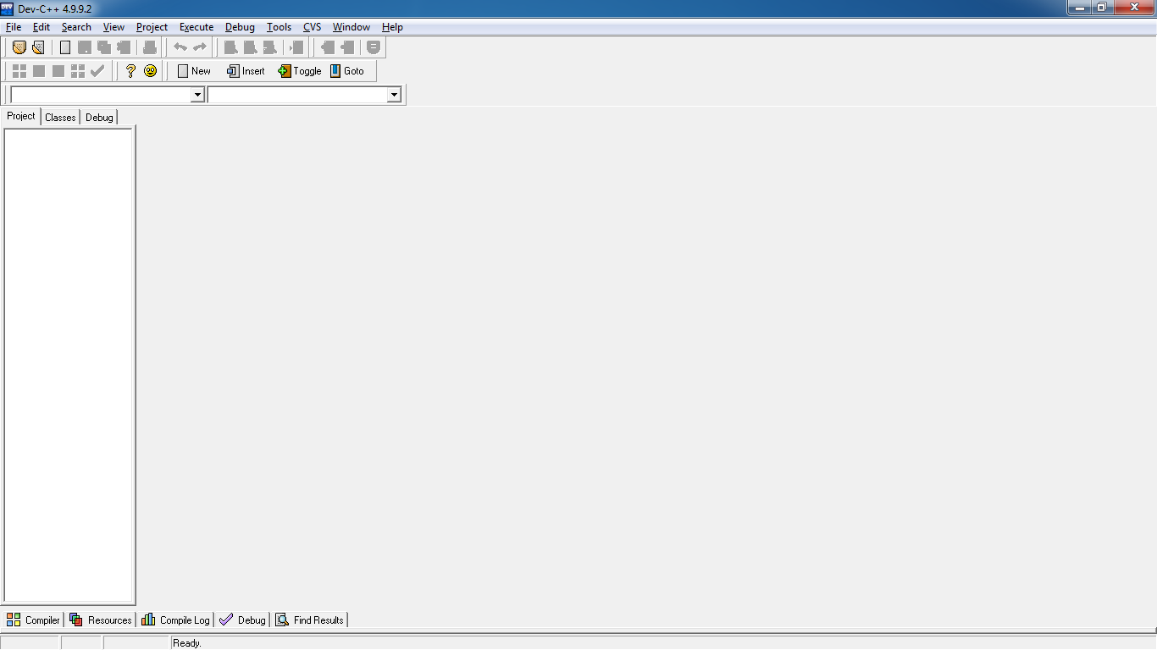
Integrated Development System Dev-C ++ IDE Framework

Slide 37
Dev-C ++ IDE Framework Implementation Process (Write Source Code)
Write Source Code
Compile
Yes
errors?
NO
Library Files
Objet Program
Link Process
User Object Programs
Executable Program
Yes
errors?
NO
END

Slide 38
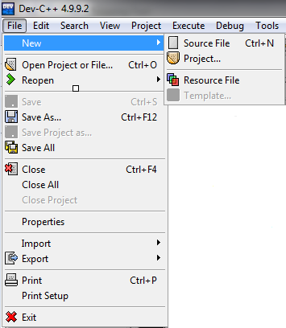
Dev-C ++ IDE Framework Implementation Process (Write Source Code)
Create a new source file:
File → New → Source File (Ctrl+N)

Slide 39
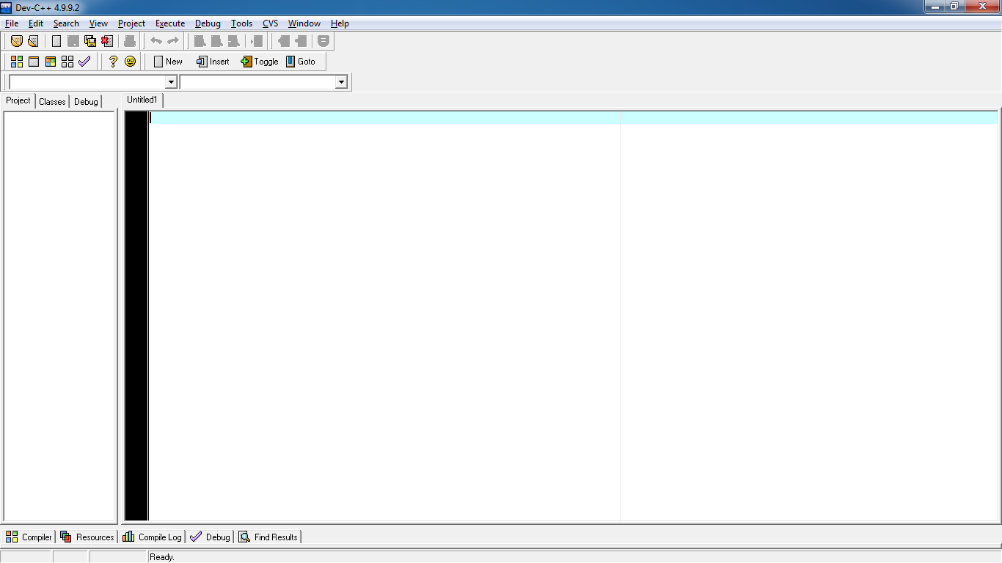
Dev-C ++ IDE Framework Implementation Process (Write Source Code)
A blank document will appear in the right pane of the main window, such that the source code is edited in it.

Slide 40
Dev-C ++ IDE Framework Implementation Process (Compile)
Write Source Code
Syntax Errors
Coherence Errors
Compile
Yes
errors?
NO
Library Files
Objet Program
Link Process
User Object Programs
Executable Program
Yes
errors?
NO
END

Slide 41
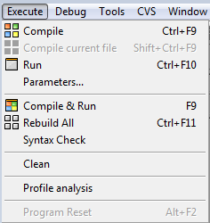
Dev-C ++ IDE Framework Implementation Process (Compile)
To compile a source file:
Execute → Compile (Ctrl+F9)
Push button
Syntax Errors: Occur when program statements do not conform to the rules of the programming language. The compiler detects wrong statements and shows information about such errors. Example: forgetting a semicolon at the end of an assignment statement.
Coherence Errors: Some examples of these type of error are:
The use of a variable is inadequate with respect to its definition.
The definition of a function does not coincide with its declaration.
When the formal parameters does not coincide with the actual parameters of a function.

Slide 42
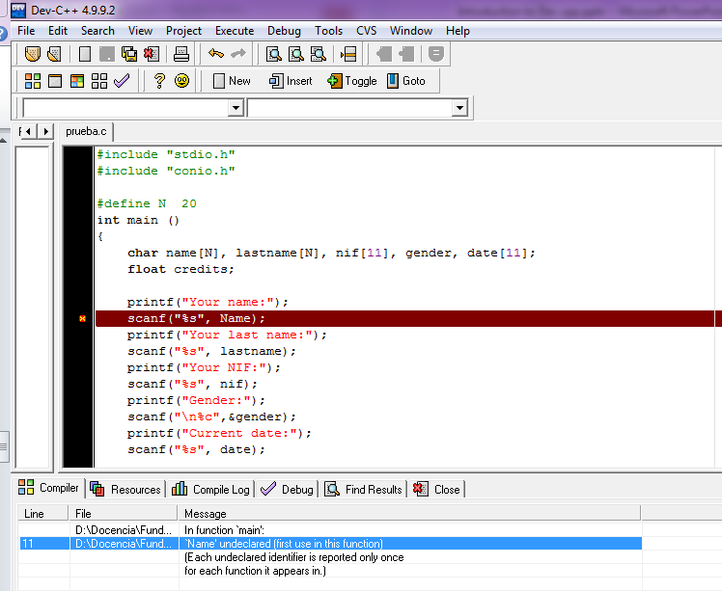
Dev-C ++ IDE Framework Implementation Process (Compile)
Source Code
Compiler’s messages after
the source code is compiled.

Slide 43
Dev-C ++ IDE Framework Implementation Process (Compile)
Write Source Code
Syntax Errors
Coherence Errors
Compile
Yes
errors?
NO
Library Files
Objet Program
Link Process
User Object Programs
Executable Program
Yes
errors?
NO
END

Slide 44
Dev-C ++ IDE Framework Implementation Process(Execute)
Write Source Code
Syntax Errors
Coherence Errors
Compile
Yes
Run-Time Errors
Semantic Errors
errors?
NO
Library Files
Objet Program
Link Process
User Object Programs
Executable Program
Yes
errors?
NO
END

Slide 45
Dev-C ++ IDE Framework Implementation Process(Execute)
To run a program:
Execute → Run (Ctrl+F10)
Push button
Run – Time Errors. These errors are those that appear when the program is running and generally, they are due to execute operations that receive inadequate values. Example: Division by zero, square root of a negative value, open a file that is corrupted.
Semantic Errors. These errors are the cause of obtaining a program with a invalid logic that provides wrong results.

Slide 46
Índex
Software development process
Version Control system
GitHub
Registration
Your first repository (arapractice00face)
GitHub Desktop
Installation & Configuration
Your first local repository (practice00face clone)
Integrated Development Environment
Devc++ IDE Framework
Installatatiom & Configuration
Practice 00 Face

Slide 47
Practice 0 Face Exercise 1 – Your First Program (Version 1)
Go to the local folder where is cloned the practice 00 (Face) and open the template (exercise1.c) using Devc++. The template is located at:
../Exercise1/exercise1.c

Slide 48
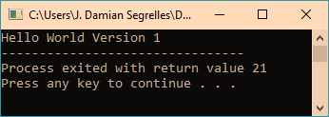
Practice 00 Face Exercise 1 – Your First Program (Version 1)
Use the function «Compile» of Dev-C++ (CTRL + F9). The source file will be compiled and a new executable file will be created.
Execute the program and test that works correctly.
The result of your program should be the follow:
If woks correctly, CONGRATULATIONS, this is the first version of your first program.
Now , you have to save the version in your Control Version Framework (HitHub).

Slide 49
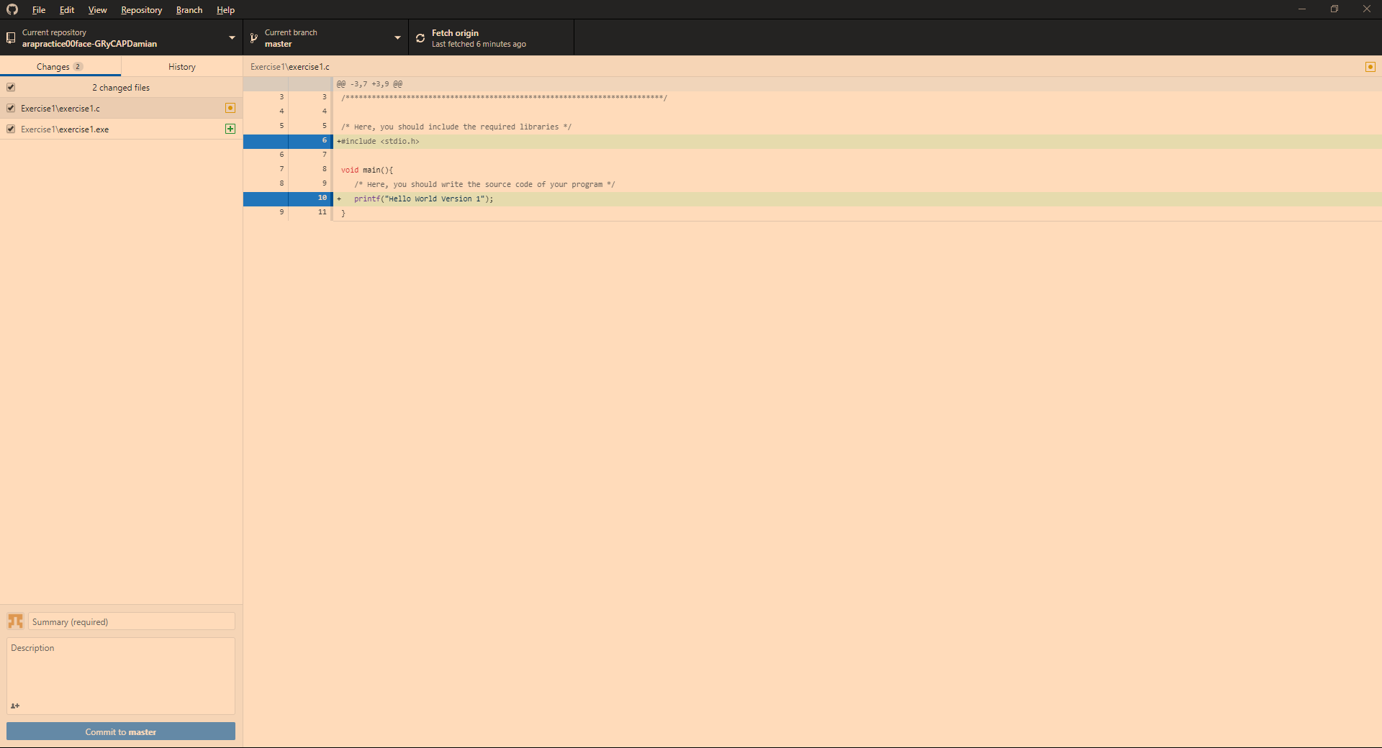
Practice 0 Face Exercise 1 – Your First Program (Version 1)
Open GitHub Desktop and you can see the changes that it has been produced in your template regarding to the last version..
You have done changes on your template but they haven't saved at the cloned local repository.

Slide 50

Practice 0 Face Exercise 1 – Your First Program (Version 1)
To save the changes to local repository you must press commit.
Write a Summary “My First Program” and press Commit

Slide 51
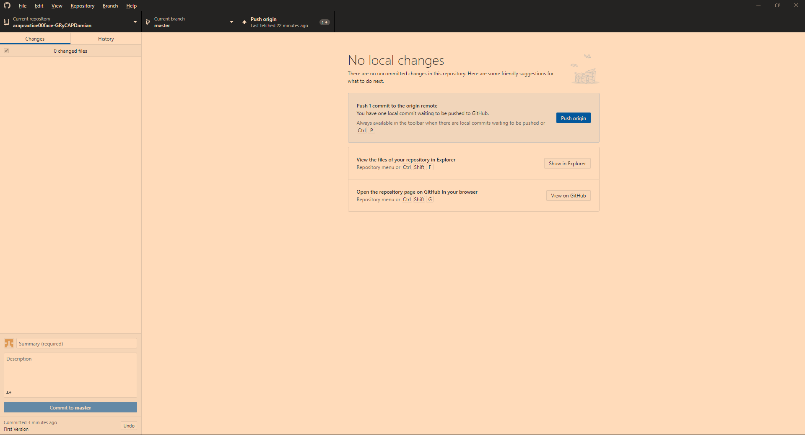
Practice 0 Face Exercise 1 – Your First Program (Version 1)
To save the changes to the GitHub repository on the cloud, you must press the “push origin” button after the commit.

Slide 52
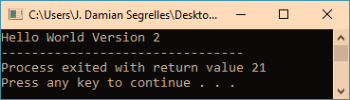
Practice 0 Face Exercise 1 – Your First Program (Version 2)
Open Devc++ and modify the program to show the message “Hello World Version 2”.
Save in the local repository this new version “Commit” and upload to the repository on the cloud (“Push”).

Slide 53
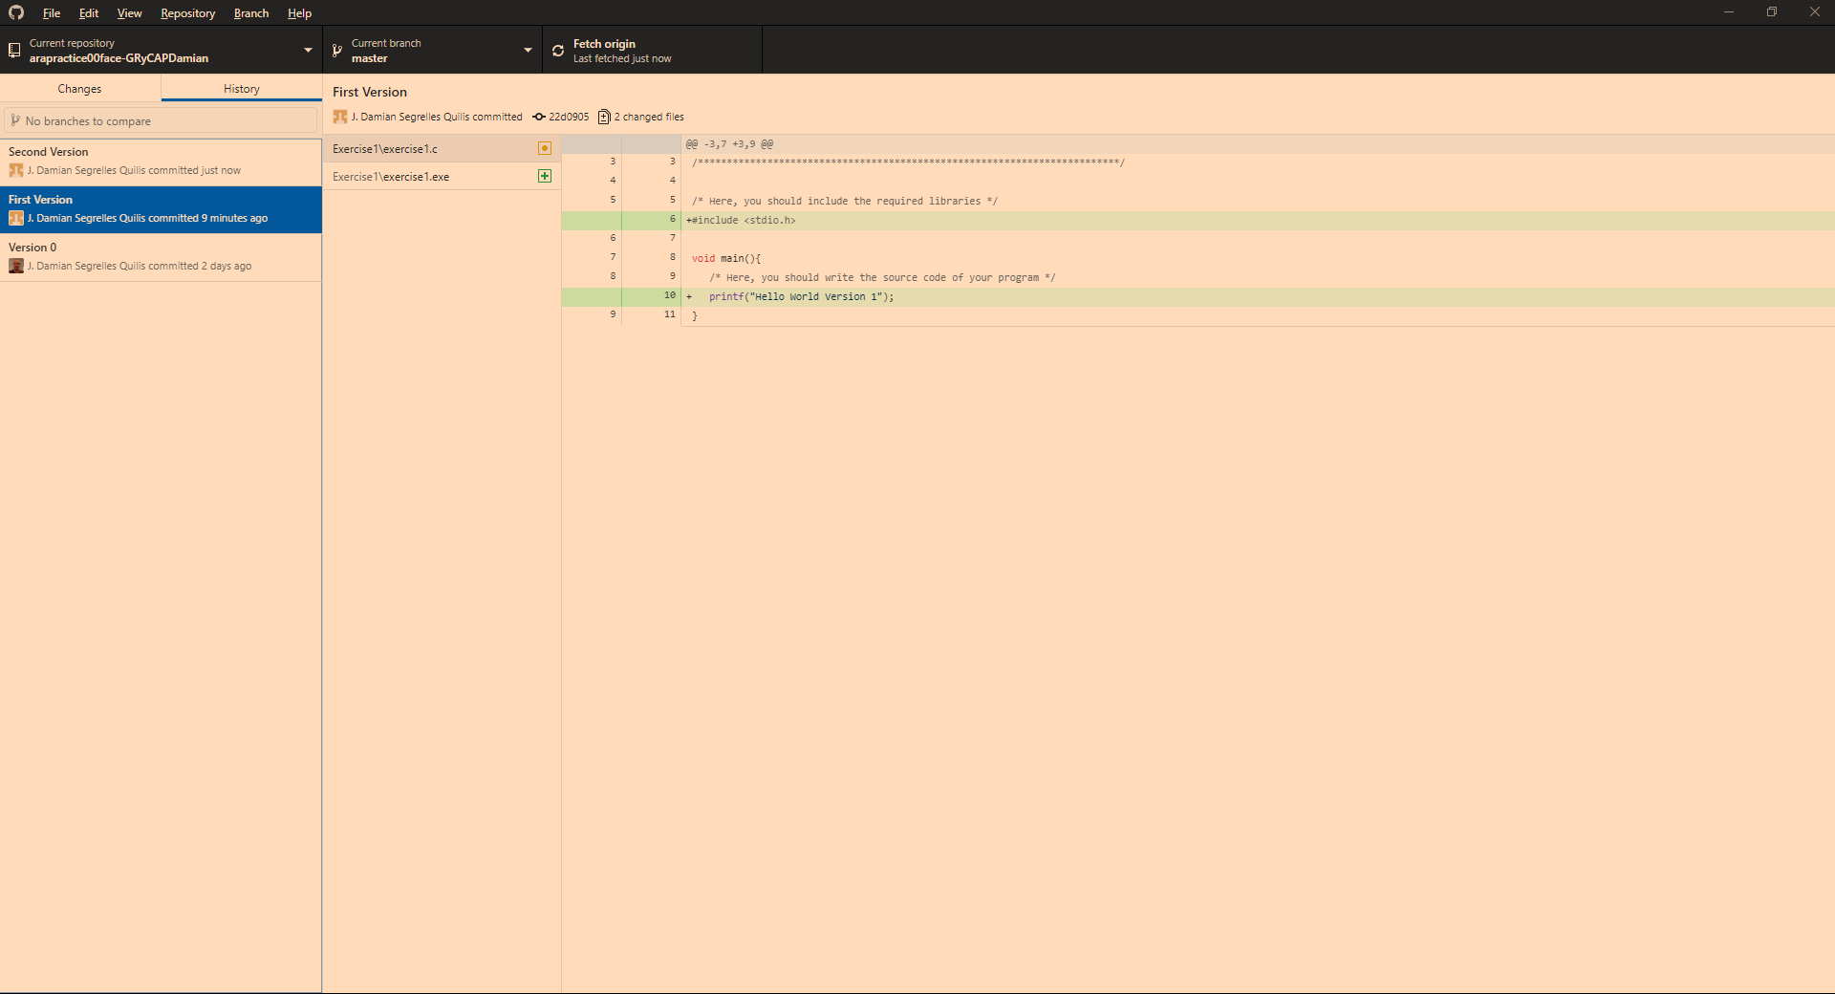
Practice 0 Face Exercise 1 – Your First Program (Version 2)
You can consult all version committed at the repository pressing the “History” and rescue old versions.

Slide 54
Practice 0 Face Exercise 2 – Your Second Program
Design and code in C language a program that it computes the sum of two numbers and show the result on screen.
When the program works (compile and execute) correctly you must save the program at local repository (commit) and upload to the cloud repository (push) as a Version 1.
Update the program to sum three numbers. When the program works (compile and execute) , you must save the program at local repository (commit) and upload it to the cloud repository (push) as a Version 2.

Slide 55
Índex
Software development process
Version Control system
GitHub
Registration
Your first repository (arapractice00face)
GitHub Desktop
Installation & Configuration
Your first local repository (practice00face clone)
Integrated Development Environment
Devc++ IDE Framework
Installatatiom & Configuration
Practice 00 Face

Slide 56
Bibliography
Collins-Sussman, Ben; Fitzpatrick, BW; Pilato, CM (2004), Version Control with Subversion, O'Reilly, ISBN 0-596-00448-6

